Slide 1

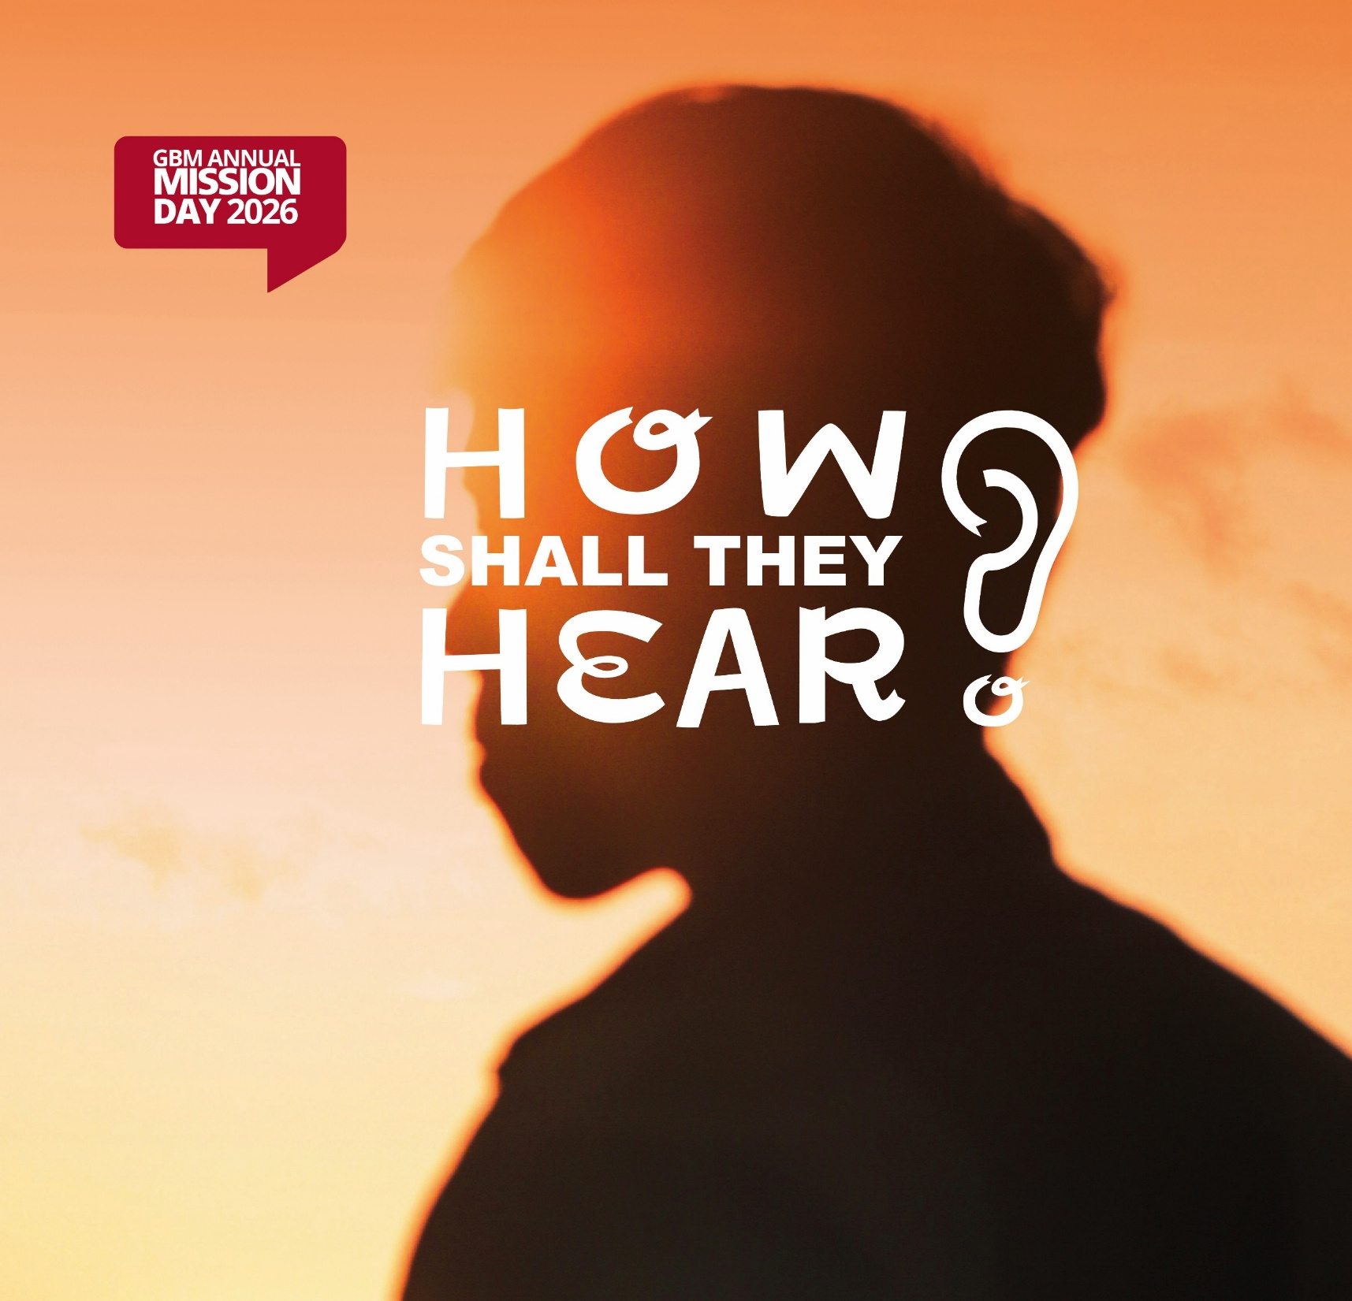
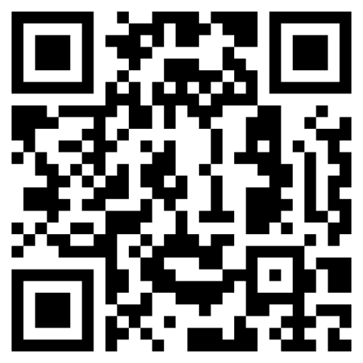

Come along for an encouraging and challenging day, featuring GBM missionary speakers:
Daniel & Ellie Caballero
Reuben & Cathy Saywell
Adrian & Abigail Yeboah
Andrzej & Monika Kempczyński
GBM Radio Team
James Hammond
Phil & Carolyn
And introducing:
Calix & Bea Furus
With children’s club during afternoon meetings
Saturday, 24 October
At Friends House, London

